Slide 1
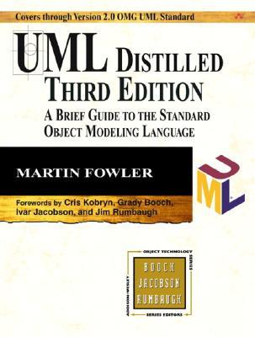
CSE 403
Design and UML Class Diagrams
Reading:
UML Distilled Ch. 3, by M. Fowler
These lecture slides are copyright (C) Marty Stepp, 2007. They may not be rehosted, sold, or modified without expressed permission from the author. All rights reserved.

Slide 2
Design phase
design: specifying the structure of how a software system will be written and function, without actually writing the complete implementation
a transition from "what" the system must do, to "how" the system will do it
  What classes will we need to implement a system that meets our requirements?
  What fields and methods will each class have?
  How will the classes interact with each other?

Slide 3
How do we design classes?
class identification from project spec / requirements
  nouns are potential classes, objects, fields
  verbs are potential methods or responsibilities of a class

Slide 4
UML class diagrams
What is a UML class diagram?
What are some things that are not represented in a UML class diagram?
  UML class diagram: a picture of the classes in an OO system, their fields and methods, and connections between the classes that interact or inherit from each other
  details of how the classes interact with each other
  algorithmic details; how a particular behavior is implemented

Slide 5
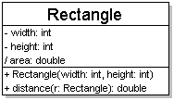
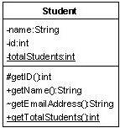
Diagram of one class
class name in top of box
  write <<interface>> on top of interfaces' names
  use italics for an abstract class name
attributes (optional)
  should include all fields of the object
operations / methods (optional)
  may omit trivial (get/set) methods
    but don't omit any methods from an interface!
  should not include inherited methods

Slide 6
Class attributes
attributes (fields, instance variables)
  visibility name : type [count] = default_value
  visibility: + public
  # protected
  - private
  ~ package (default)
  / derived
  underline static attributes
  derived attribute: not stored, but can
  be computed from other attribute values
  attribute example:
  - balance : double = 0.00

Slide 7
Class operations / methods
operations / methods
  visibility name (parameters) : return_type
  visibility: + public
  # protected
  - private
  ~ package (default)
  underline static methods
  parameter types listed as (name: type)
  omit return_type on constructors and
  when return type is void
  method example:
  + distance(p1: Point, p2: Point): double

Slide 8
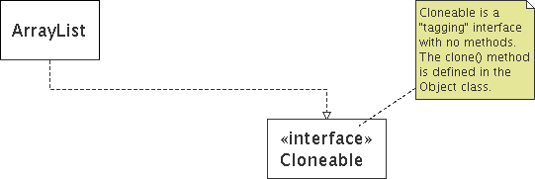
Comments
represented as a folded note, attached to the appropriate class/method/etc by a dashed line

Slide 9
Relationships btwn. classes
generalization: an inheritance relationship
  inheritance between classes
  interface implementation
association: a usage relationship
  dependency
  aggregation
  composition

Slide 10
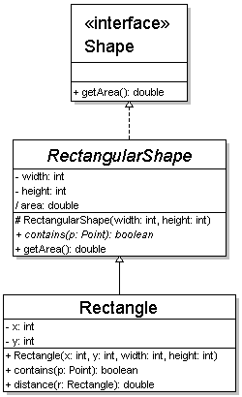
Generalization relationships
generalization (inheritance) relationships
  hierarchies drawn top-down with arrows pointing upward to parent
  line/arrow styles differ, based on whether parent is a(n):
    class:
    solid line, black arrow
    abstract class:
    solid line, white arrow
    interface:
    dashed line, white arrow
  we often don't draw trivial / obvious generalization relationships, such as drawing the Object class as a parent

Slide 11
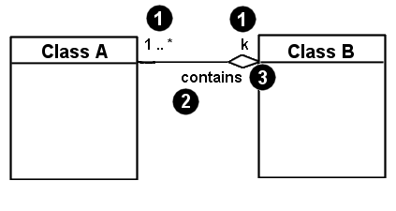
Associational relationships
associational (usage) relationships
  1. multiplicity (how many are used)
    * ⇒ 0, 1, or more
    1 ⇒ 1 exactly
    2..4 ⇒ between 2 and 4, inclusive
    3..* ⇒ 3 or more
  2. name (what relationship the objects have)
  3. navigability (direction)

Slide 12
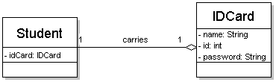
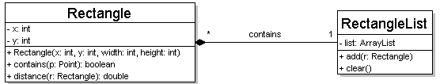
Multiplicity of associations
one-to-one
  each student must carry exactly one ID card
one-to-many
  one rectangle list can contain many rectangles

Slide 13
Association types
Car
1
1
aggregation
aggregation: "is part of"
  symbolized by a clear white diamond
composition: "is entirely made of"
  stronger version of aggregation
  the parts live and die with the whole
  symbolized by a black diamond
dependency: "uses temporarily"
  symbolized by dotted line
  often is an implementation
  detail, not an intrinsic part of
  that object's state
Engine
Book
composition
1
*
Page
dependency
Lottery
Ticket
Random

Slide 14
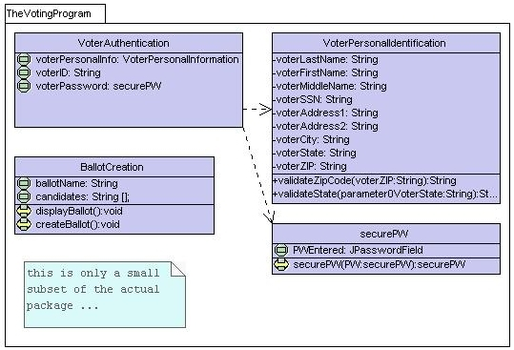
Class diagram example 1

Slide 15
Class diagram example 2
Multiplicity
Customer
1
Simple
Aggregation
Class
Abstract
Class
Rental Invoice
Rental Item
1..*
1
0..1
Composition
Simple
Association
Generalization
Checkout Screen
DVD Movie
VHS Movie
Video Game

Slide 16
Class diagram example 3
StudentBody
Student
1
100
- firstName : String
- lastName : String
- homeAddress : Address
- schoolAddress : Address
+ main (args : String[])
+ toString() : String
Address
- streetAddress : String
- city : String
- state : String
- zipCode : long
+ toString() : String

Slide 17
Tools for creating UML diags.
Violet (free)
  http://horstmann.com/violet/
Rational Rose
  http://www.rational.com/
Visual Paradigm UML Suite (trial)
  http://www.visual-paradigm.com/
  (nearly) direct download link:
  http://www.visual-paradigm.com/vp/download.jsp?product=vpuml&edition=ce
(there are many others, but most are commercial)

Slide 18
Class design exercise
Consider this Texas Hold 'em poker game system:
  2 to 8 human or computer players
  Each player has a name and stack of chips
  Computer players have a difficulty setting: easy, medium, hard
  Summary of each hand:
    Dealer collects ante from appropriate players, shuffles the deck, and deals each player a hand of 2 cards from the deck.
    A betting round occurs, followed by dealing 3 shared cards from the deck.
    As shared cards are dealt, more betting rounds occur, where each player can fold, check, or raise.
    At the end of a round, if more than one player is remaining, players' hands are compared, and the best hand wins the pot of all chips bet so far.
  What classes are in this system? What are their responsibilities? Which classes collaborate?
  Draw a class diagram for this system. Include relationships between classes (generalization and associational).

